Slide 1



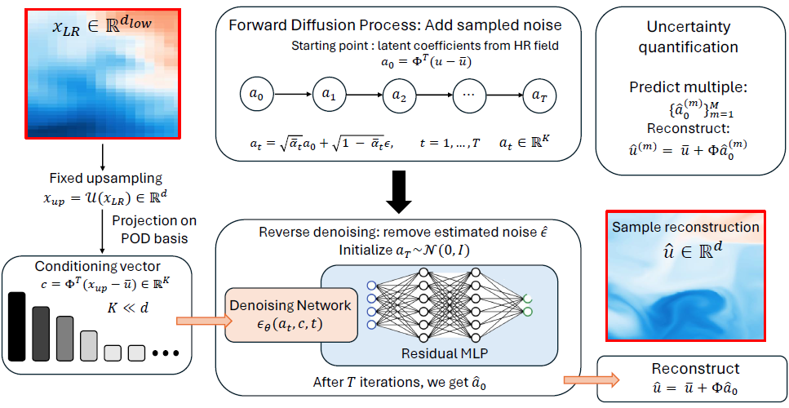
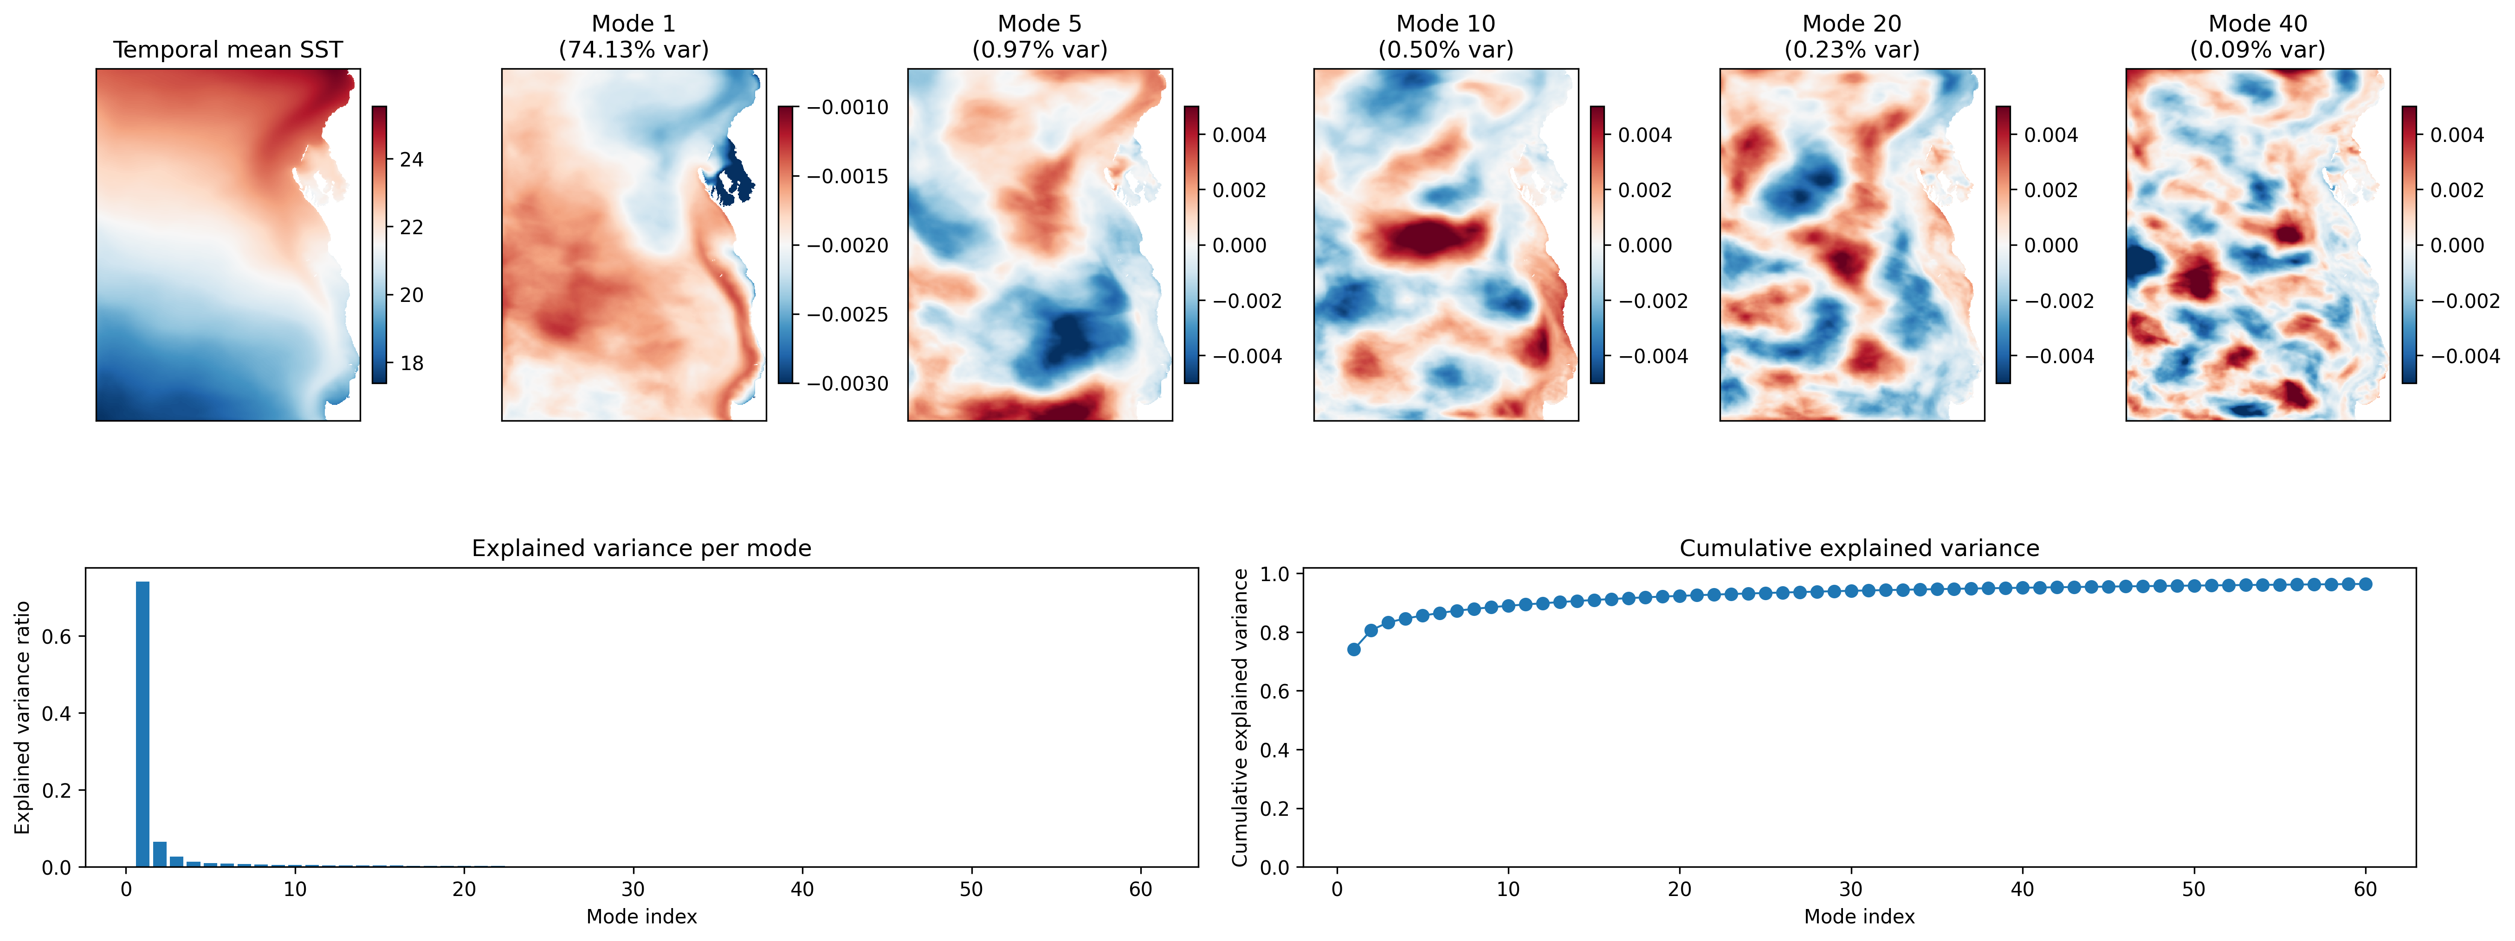

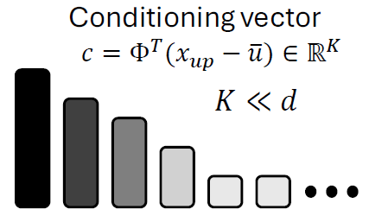




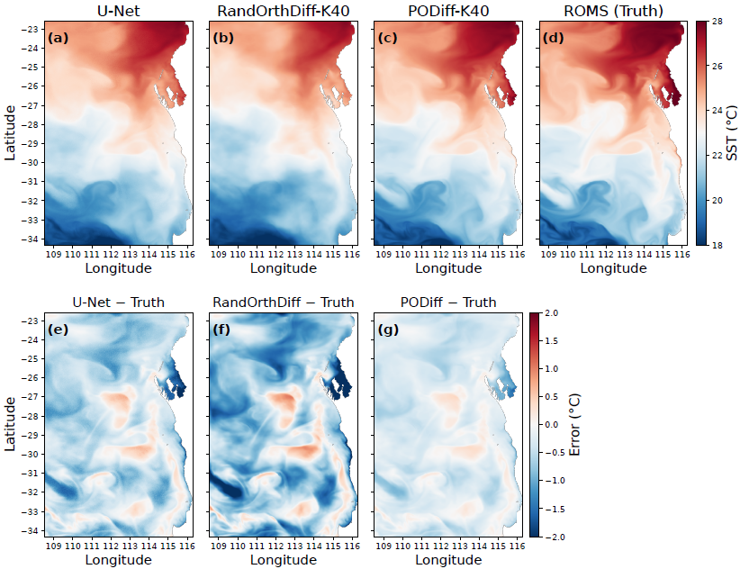
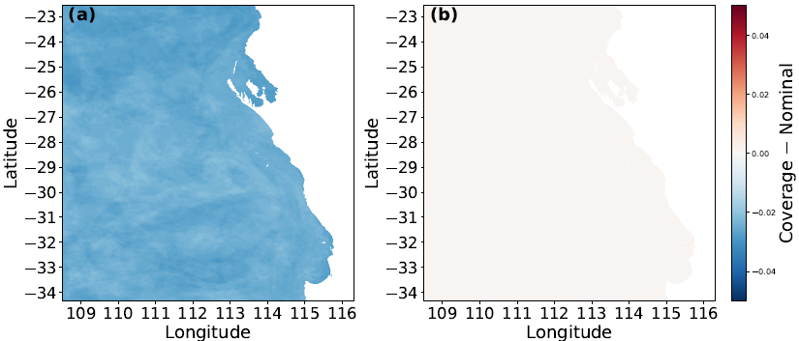
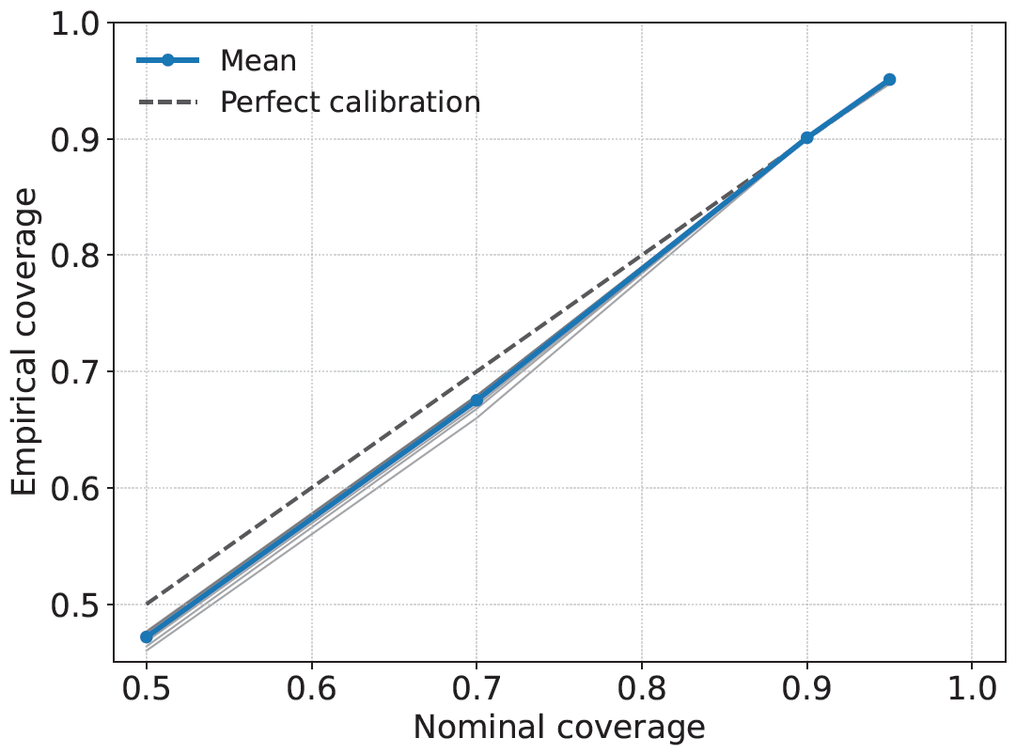



PODiff: Latent Diffusion in Proper Orthogonal Decomposition
Space for Scientific Super-Resolution
Paper (arXiv) | Code (GitHub) | Interactive Demo
arXiv: 2605.03399 | OnkaraJadhav/PODiff | HF Demo: SST
Efficient, interpretable, and well-calibrated probabilistic super-resolution of scientific fields from low-resolution inputs
Onkar Jadhav, Tim French, Matthew Rayson, Nicole L. Jones
¹ School of Earth and Oceans, UWA Oceans Institute, The University of Western Australia
² School of Physics, Mathematics and Computing, The University of Western Australia
TL;DR
Motivation & Core Idea
PODiff Framework: Conditional Diffusion in POD Space
POD Modes Capture Multi-Scale Ocean Variability
Diffusion in POD space variance-ordered, orthogonal, interpretable latent space
■ Scientific fields are high-dimensional and expensive to model directly in pixel space.
⏱ Pixel-space diffusion is accurate but often slow and memory-intensive.
Efficient & scalable: much lower compute and memory than pixel-space diffusion
💡 PODiff moves diffusion into a compact, variance-ordered POD latent space for efficient probabilistic super-resolution.
Well-calibrated uncertainty: high empirical coverage and spatially meaningful uncertainty
→
→
→
State-of-the-art results: strong accuracy with much lower cost
Low-res
field (LR)
POD
coefficients
Diffusion in
latent space
High-res
recon. (HR)
Key idea: denoise only the dominant POD coefficients, then reconstruct the full field.
70%+ of total variance captured by the first POD mode alone!
SST Downscaling over Western Australian Coast
Well-Calibrated & Spatially Structured Uncertainty
Quantitative Results (SST Downscaling)
Reconstruction Error Metrics (All days)
Empirical Coverage
Empirical coverage (PODiff-K40)
Coverage − Nominal
Reliability (Coverage vs. Nominal)
MODEL | RMSE | MAE | EXTREME RMSE | EXTREME MAE
PODiff-K40 (ours) | 0.3923 | 0.2976 | 0.4836 | 0.3537
PIXELDIFF | 0.4118 | 0.3158 | 0.4899 | 0.3600
VAE-LDM | 0.4011 | 0.3005 | 0.4889 | 0.3591
U-Net | 0.6788 | 0.5141 | 0.8366 | 0.6109
RandOrthDiff | 0.9987 | 0.7577 | 1.2309 | 0.9003
Nominal Level | PODiff-K40 | MC Dropout U-Net | PixelDiff
50% | 0.4717 | 0.4111 | 0.4658
70% | 0.6849 | 0.6508 | 0.6799
90% | 0.9009 | 0.8871 | 0.9010
95% | 0.9571 | 0.9401 | 0.9551
PODiff achieves lower error, especially near the coast and in strong gradient regions.
Computational Cost (Per Sample)
⚡ PODiff is 30–100× faster at inference and uses 2–5× less GPU memory than pixel-space diffusion!
Method | Params | Peak GPU Mem | Training Time | Inference Time per Sample
PODiff (K=40) (ours) | 0.20M | 1.4 GB | 3.8 h | 0.08 s
U-Net | 33M | 8.8 GB | 8.2 h | 0.05 s
PixelDiff | 33M | 12.5 GB | 48 h | 1.24 s
VAE-LDM | 39M | 13.1 GB | 28 h | 0.88 s
PODiff achieves high empirical coverage across all confidence levels with minimal bias.
🏆
Key Takeaway
Applications
🤝
Acknowledgments
By performing diffusion in a variance-ordered POD space, PODiff achieves state-of-the-art reconstruction accuracy with well-calibrated, spatially structured uncertainty at a fraction of the computational cost.
≈
Climate & ocean model downscaling
☁
Weather & extreme event analysis
∴
Data assimilation & digital twins
🌀
Other PDE-governed spatial systems
We acknowledge the Stan Perron Supercomputer Initiative (ICSI) and Pawsey Supercomputing Centre with support from the Australian Government.

